Slide 1

Netflix Movies and TV Shows

Slide 2
Evaluation of Netflix Movies and TV Shows
Group Members
Geraldo Bedoya
Khristopher Prince
Chuchu Wang
Outline of Presentation:
Data cleaning process
IMDb Movies votes vs Netflix
Global Distribution
Future Outlook

Slide 3
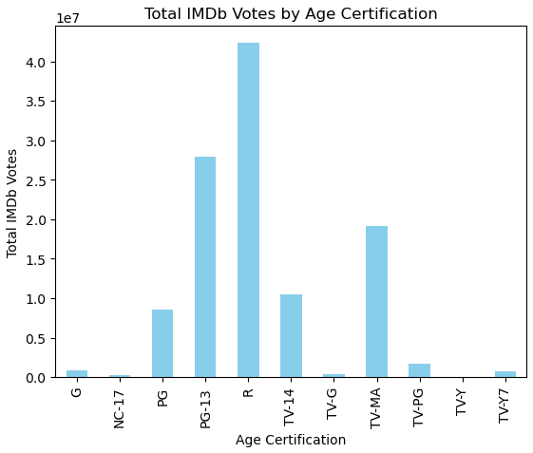
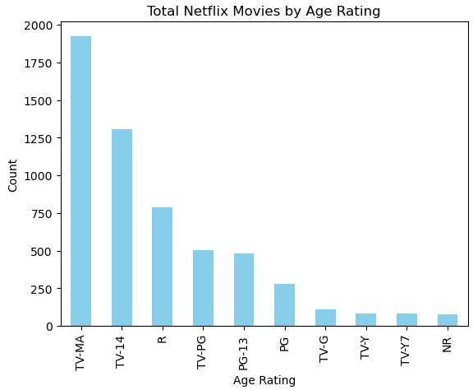
Most popular Movie rating

Slide 4
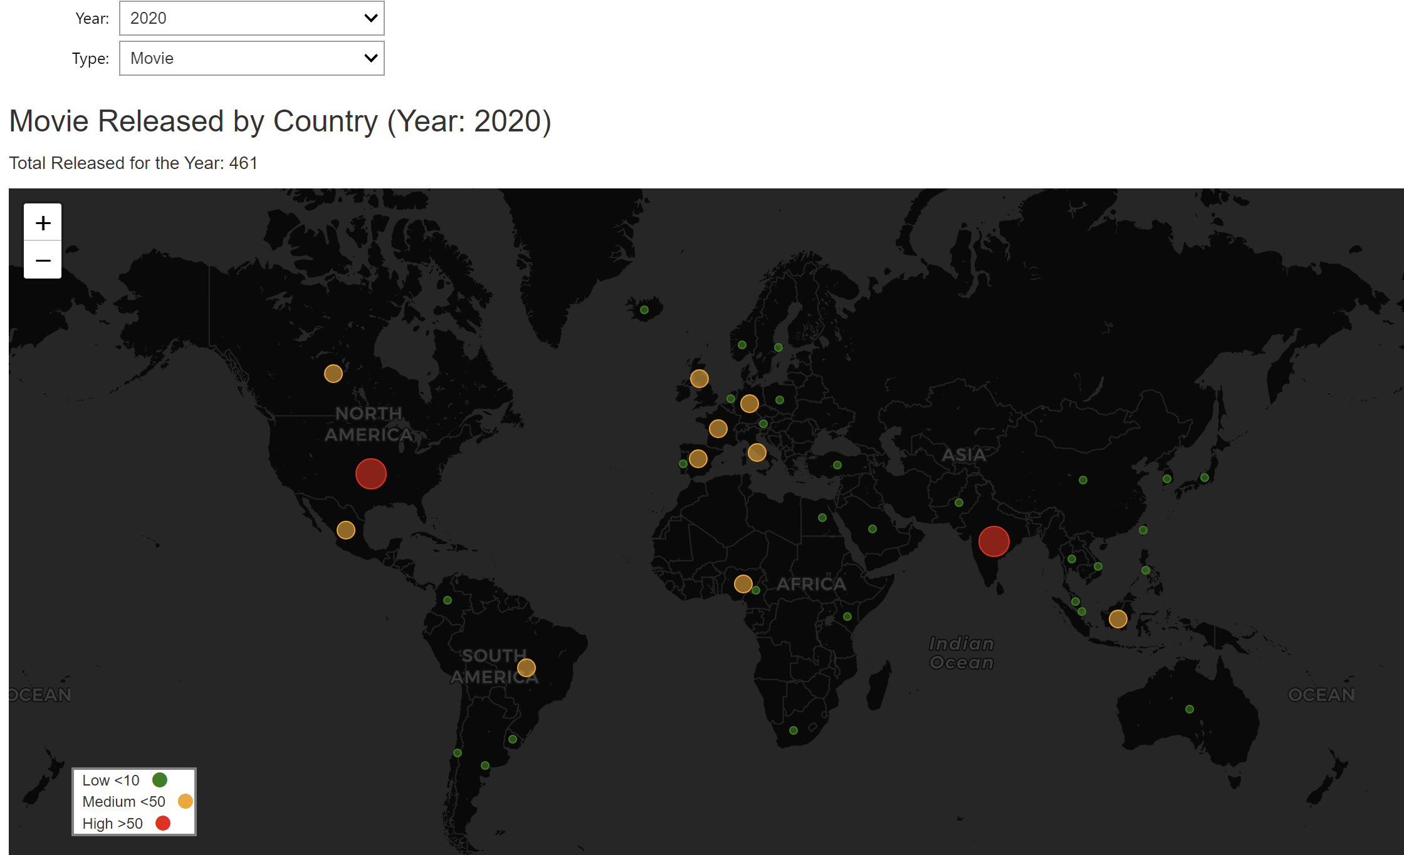
Interactive Map
Global Distribution
Temporal Trends
Production Density

Slide 5
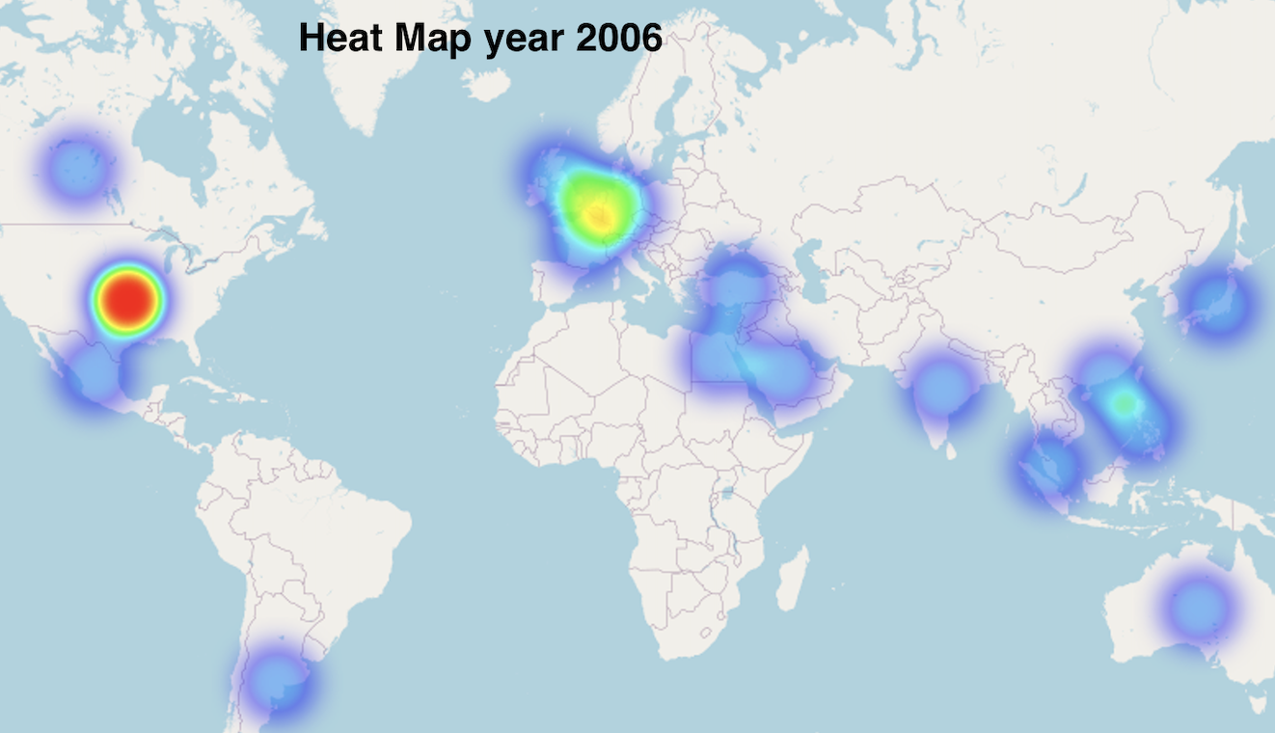
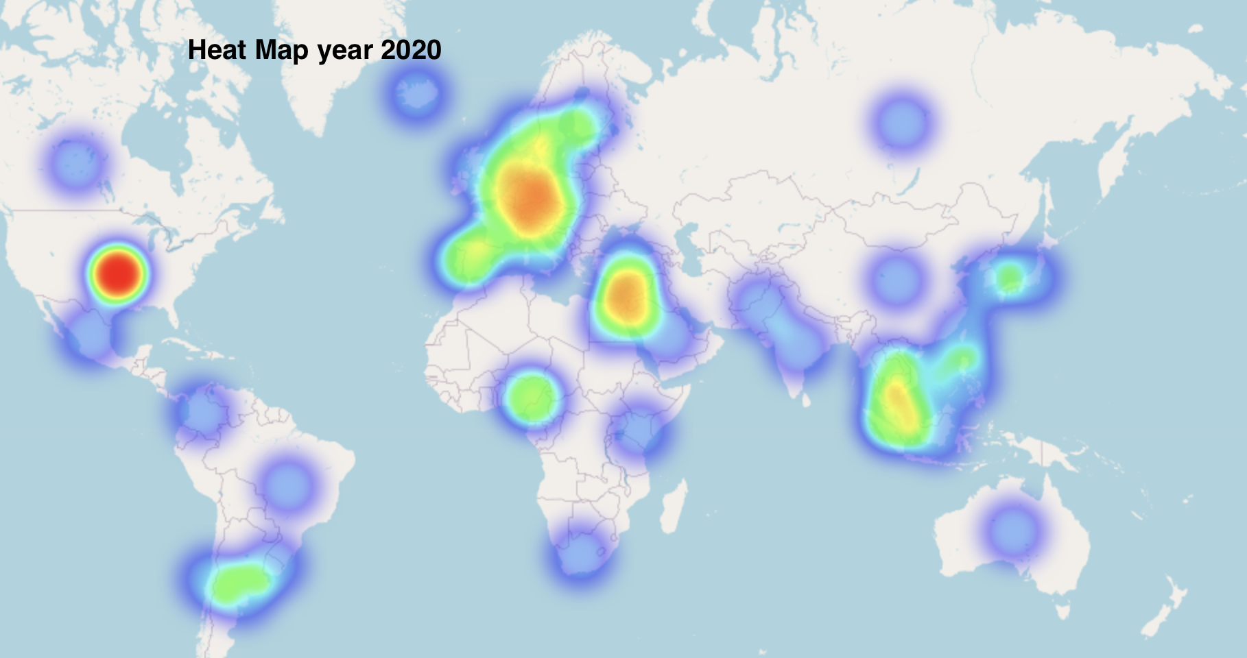
Global Production Trend

Slide 6
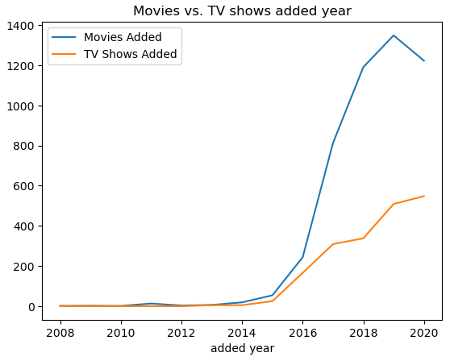
Movies vs. TV shows Trending
Based on added year
Compare the number of movies and TV shows added in Netflix for each year

Slide 7
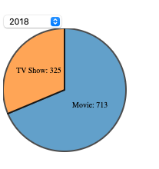
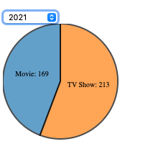
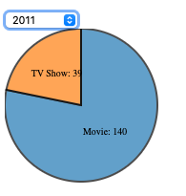
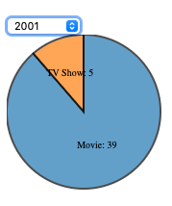
Movies vs. TV shows Trending
Based on released year
Increased percentage of TV shows production

Slide 8
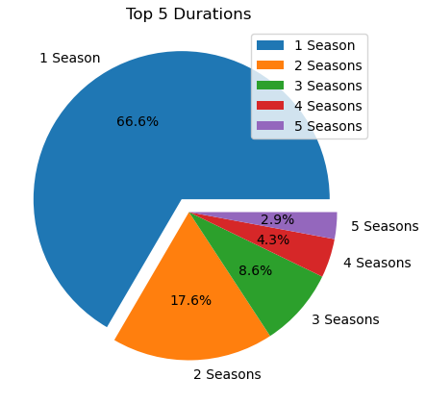
TV shows duration
TV shows with 1-2 seasons are popular
Season ranges increase audience engagement

Slide 9

Reference:
https://www.kaggle.com/datasets/shivamb/netflix-shows/data
https://www.kaggle.com/datasets/thedevastator/netflix-imdb-scores/data
https://www.kaggle.com/datasets/paultimothymooney/latitude-and-longitude-for-every-country-and-state/code

